Slide 1

Predicting Workforce Automation Risk by 2030: A Supervised Classification Model Leveraging Multi-Dimensional Skill Features
Hassan wajid
hasanwajid49635@gmail.com
03555401102
Artificail intelligence and data science
Haffizudin

Slide 2

Problem Background
AI's impact on employment globally
The rapid rise of Generative AI, a general-purpose technology, is changing the labor market at an unprecedented speed.

Slide 3
Problem Statement
Project Goals
The Problem
01
03
predict which job roles are at the highest risk of automation by technology like AI
The overarching goal of the project was to successfully develop, train, and evaluate a robust machine learning classification model capable of accurately predicting job automation risk
Industry Relevance:
This work is highly relevant to workforce planning, education policy, and the technology sector
02

Slide 4
Project Objectives
develop a supervised machine learning model
To improve decision-making
01
03
performance metrics (Accuracy, Precision, Recall, F1-score) that quantify the model's
that assigns each job role to one of three distinct automation risk categories: Low, Medium, or High.
To produce accurate predictions
To analyze multi-dimensional skill data
02
04
AI exposure metrics to determine their collective predictive power in forecasting job displacement.
achieving high overall accuracy (aiming for above 90%, which was met with the Oversampling model achieving 91%)

Slide 5
Commonly used Tooles and there purpose
Tool/Library | Purpose in the Project
Python | The primary programming language used to execute all data handling, model training, and evaluation tasks.
Jupyter/Colab Notebooks | The interactive environment used to write and run the code, document the methodology, and display the results and visualizations step-by-step.
Pandas | Used for data manipulation and analysis. This library was critical for reading the dataset, cleaning the data (e.g., handling missing values and dropping columns), and preparing the data for the model.
NumPy | Used for numerical operations and handling arrays. It supports large, multi-dimensional arrays and matrices, which is fundamental for mathematical calculations in machine learning.
Scikit-learn (sklearn) | The essential machine learning library used for almost all model-related tasks, including:
Matplotlib / Seaborn | Used for data visualization. While specific plots were not present in the final reports, these libraries were used for initial data exploration and to understand feature distributions or class imbalances.

Slide 6
Step by step Methodology Model
Data Collection and Initial Loading
Data Preprocessing and Cleanin
Feature Engineering and Scaling
Data Splitting and Class Balancing (Three Experiments)
Experiment 1 (Oversampling)
Experiment 2 (SMOTE)
Experiment 3 (Undersampling)
Model Selection and Training
Algorithm Choice(Five Algorithams)
Model Training(80% and 20%)
Model Evaluation and Comparison
Precision, Recall, and F1-score

Slide 7
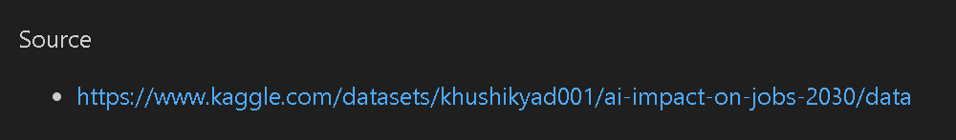
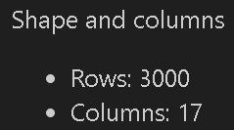

Define Data Source , Collection Process and Data Structure and Attributes
The dataset was loaded from a single source, identified as a Kaggle dataset,
The initial dataset contained 3000 samples (rows) and 17 features (columns)
The data set structure and attributes.

Slide 8

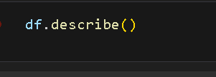
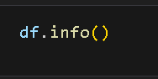
EDA steps and findings
load the data
Exploratry data analysis

Slide 9
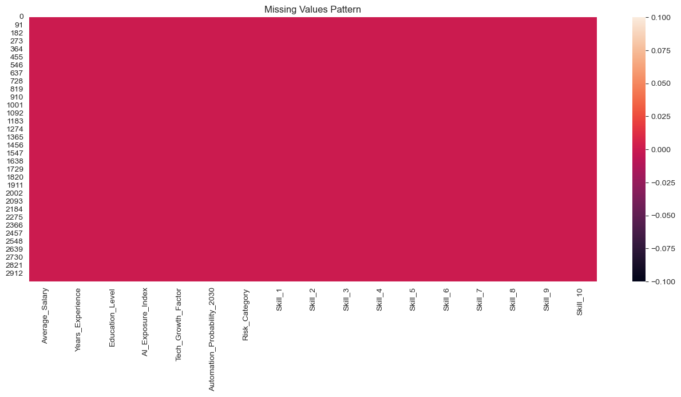
EDA steps and findings
check missing values

Slide 10
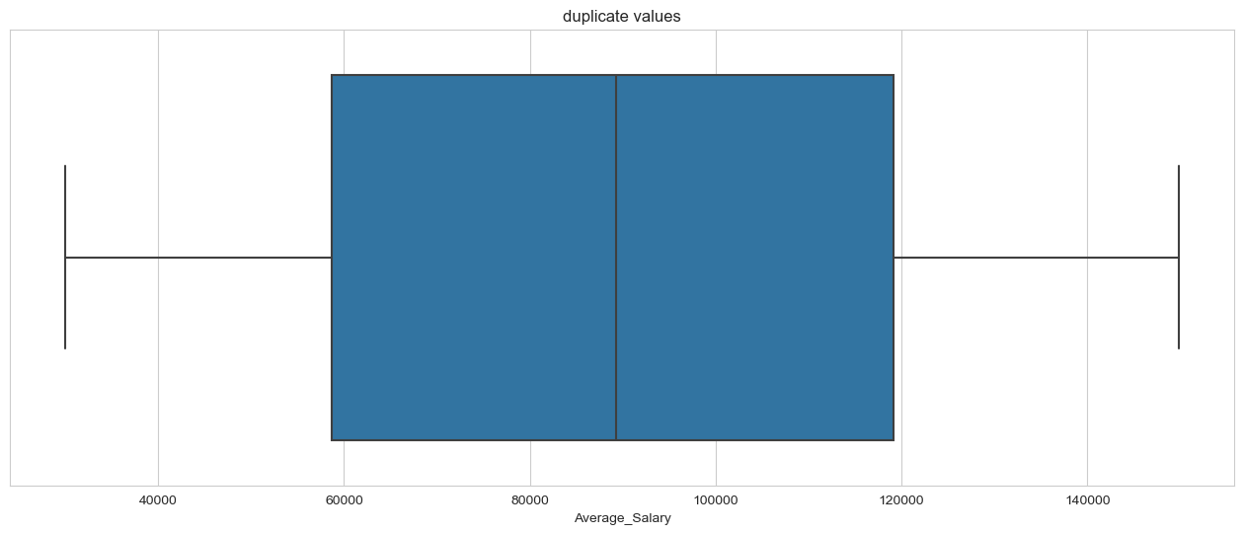
EDA steps and findings
check outliers

Slide 11
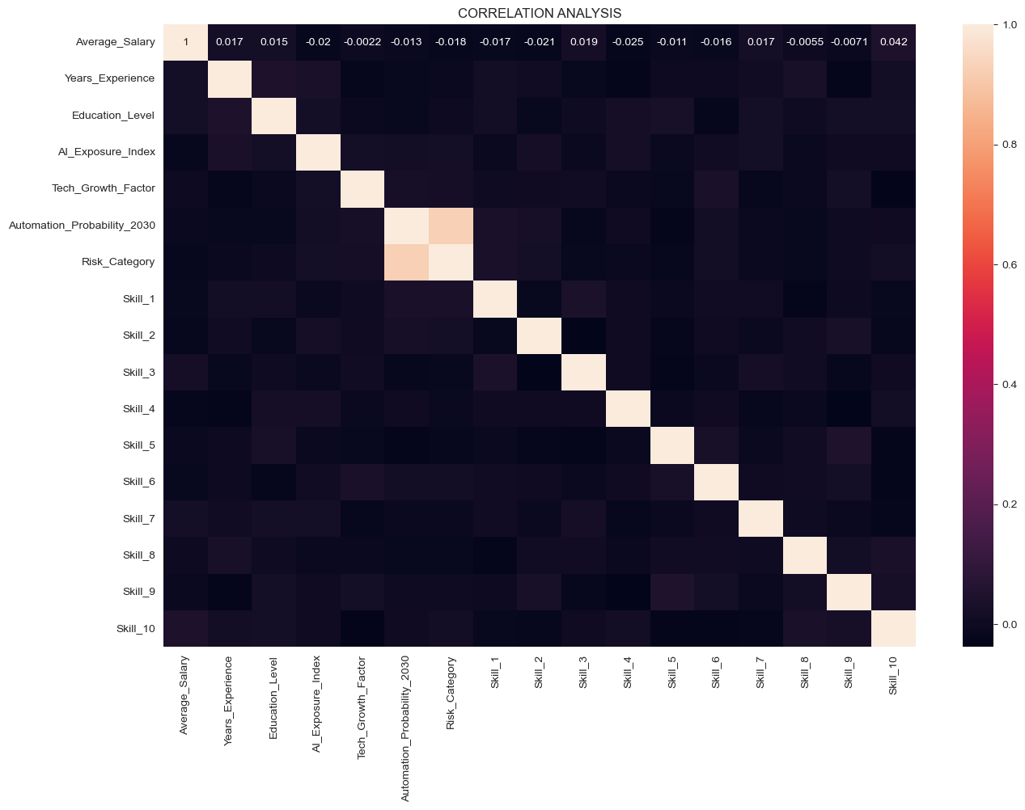
EDA steps and findings
correlation analysis

Slide 12
Prepossessing steps and why these steps are used
1 Data Collection
ML witout data impossible
best data = best model
2 Understand the Data (EDA – Exploratory Data Analysis)
Data understand
Errors, outliers, imbalance detect
Decide into next steps
3 Remove Duplicate Data
Duplicate data baisness of model
wrong accuracy

Slide 13
Prepossessing steps and why these steps are used
⿤Handle Missing Values
ML algorithms not handle to missing values
Error and wrong prediction to safe
Handle Outliers
Outliers detect to model confuse
Accuracy and generalization improve it
Encoding Categorical Data
ML models only understand numbers
Text directlynot process

Slide 14
Final applied analysis steps and why
To Convert Categorical data into numerical form, which ML algorithms require
To apply Feature Scaling so all features contribute equally to learning
To select Important Features and remove irrelevant ones to avoid overfitting

Slide 15
Final applied analysis steps and why
To Balance the dataset in classification problems to avoid biased results
To Split data into Training and Testing sets for fair model evaluation
To Model selection and evalution becouse train model
To improve model accuracy, stability, and generalization

Slide 16
Results and Discussion
five machine learning classification models were trained and evaluated to compare their performance
1.Logistic Regression
2.Support Vector Machine (SVM)
Accuracy: | 98.68%
Precision: | 98.70%
Recall: | 98.69%
F1-Score: | 98.68%
Accuracy: | 96.71%
Precision: | 96.80%
Recall: | 96.71%
F1-Score: | 96.68%

Slide 17
Results and Discussion
3.K-Nearest Neighbors (KNN)
4.Decision Tree Classifier
Accuracy: | 78.09%
Precision: | 77.69%
Recall: | 78.09%
F1-Score: | 77.35%
Accuracy: | 100%
Precision: | 100%
Recall: | 100%
F1-Score: | 100%

Slide 18
Results and Discussion
5.Random Forest
Random Forest achieved perfect results on all evaluation metrics. This indicates that the model classified all samples correctly.
Random Forest is an ensemble model that combines multiple decision trees, which helps reduce overfitting and improve accuracy
Accuracy: | 100%
Precision: | 100%
Recall: | 100%
F1-Score: | 100%

Slide 19
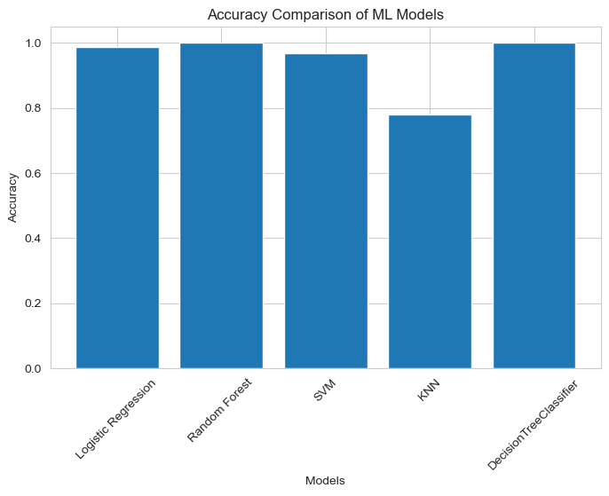
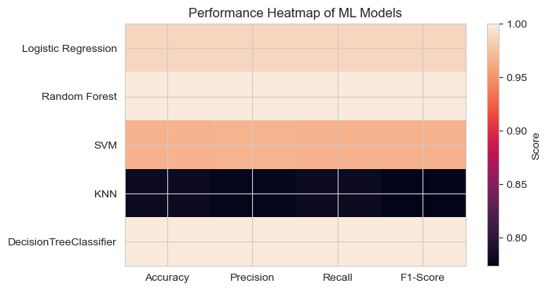
Results and Discussion
Overall Comparison and Final Discussion
From the results, Random Forest and Decision Tree achieved the best performance with 100% accuracy.
Logistic Regression and SVM also performed very well with accuracies above 96%, showing strong generalization.
KNN had comparatively poor performance and is not recommended for this dataset.

Slide 20
Conclusion
AI_Impact_on_Jobs_2030 dataset (approximately 300 curated samples), which combines detailed job descriptors, quantitative skill dimensions, and analytically derived AI exposure metrics.
he primary objective of this study is to design and evaluate a highly granular supervised classification framework capable of categorizing occupations into Low, Medium, or High Automation Risk by the year 2030.
the project will rigorously address the ethical constraint of algorithmic bias and prioritize model explainability to ensure the outputs

Slide 21
Conclusion
The machine learning project successfully created a supervised classification model, specifically a Random Forest Classifier, for predicting workforce automation risk across three categories: Low, Medium, and High Risk by 2030
This high level of performance confirmed the usefulness of the approach in addressing the problem of predicting job displacement by modern AI using multi-dimensional skill and exposure data.
Comparing the Classification Reports from the three experiments (Oversampling, SMOTE, Undersampling) and selecting the model with the highest overall performance metrics

Slide 22
THANK YOU

